Slide 1
Build Web Games
Chapter 10: A complete game

Slide 2
HTML document structure
<!DOCTYPE html>
<html>
<head>
<title>
</title>
<style>
</style>
</head>
<body>
<div>
</div>
<script>
</script>
</body>
</html>

Slide 3
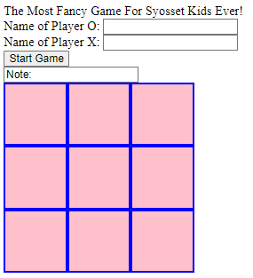
Add more contents – add HTML elements
<header>
The Most Fancy Game For Syosset Kids Ever!
</header>
<form>
<div>
<label for="oName">Name of Player O: </label>
<input id="oName" type="text">
</div>
<div>
<label for="xName">Name of Player X: </label>
<input id="xName" type="text">
</div>
<input id="startGame" type="button" value="Start Game"> <br/>
<input id="idNote" type="text" value="Note: ">
</form>

Slide 4
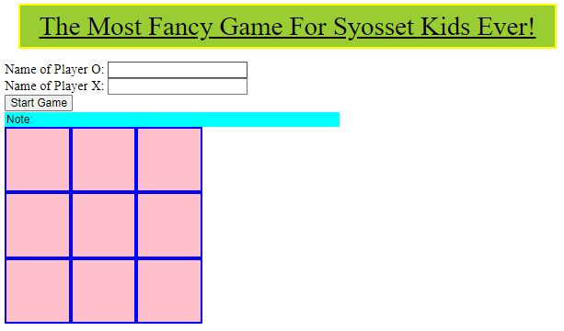
Add more contents – Style HTML elements
header {
font-size: 2em;
background-color: yellowgreen;
text-decoration: underline;
text-align: center;
margin: 0.5em;
padding: 0.2em;
border: 3px solid yellow;
}
#idNote {
border: none;
width: 400px;
background-color: aqua;
}

Slide 5
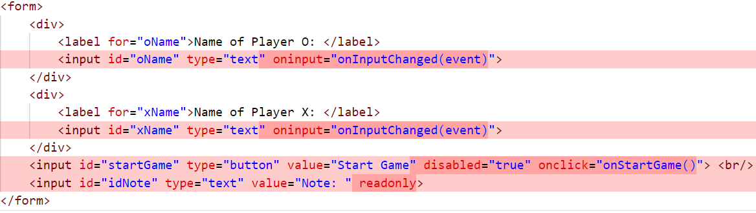
Add more contents – Add event handlers

Slide 6
Event handler - onInputChanged
let winner = "";
let isGameStarted = false;
function onInputChanged(evt) {
const oName = document.getElementById('oName');
const xName = document.getElementById('xName');
const startGame = document.getElementById('startGame');
startGame.disabled = oName.value === "" || xName.value === "";
updateNote();
}

Slide 7
Event handler - onstartgame
function onStartGame() {
const startGame = document.getElementById('startGame');
startGame.value = "Restart Game"
for (let i=0; i < 3; ++i) {
for (let j=0; j < 3; ++j) {
const id = "" + i + "_" + j;
document.getElementById(id).innerText = "";
}
}
isGameStarted = true;
activeLetter = "O";
winner = "";
updateNote();
}

Slide 8
Event handler - updatenote
function updateNote() {
const oName = document.getElementById('oName');
const xName = document.getElementById('xName');
const note = document.getElementById('idNote');
const startGame = document.getElementById('startGame');
const name = activeLetter === "O" ? oName.value : xName.value;
note.style.backgroundColor = "aqua";
if (winner !== "") {
note.value = "Note: Game finished. Winner is: " + winner + ". Click 'Restart Game'!";
note.style.backgroundColor = "red";
}
else if (startGame.disabled) {
note.value = "Note: Input your name";
}
else if(startGame.value === "Start Game") {
note.value = "Note: Click Start Game button";
}
else {
note.value = "Note: Current player is " + name + " to play " + activeLetter ;
}
}

Slide 9
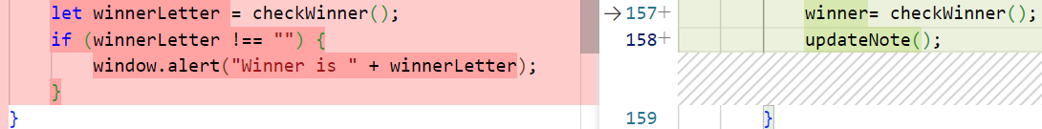
Enhance onElementClicked
function onElementClicked(event) {
// when not ready or game finished
if (document.getElementById('startGame').disabled) {
window.alert("Please finish the game setup");
return;
}
if (isGameStarted === false) {
window.alert("Please clock 'Start Game' button to start the game");
return;
}
if (winner !== "") {
window.alert("Game finished, Click 'Restart Game' button to start a new game");
return;
}
const element = event.target;
… }

